Slide 1
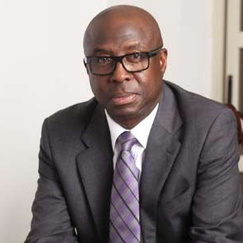
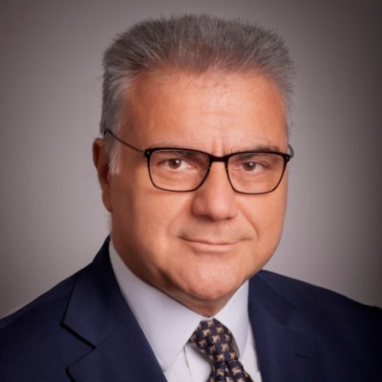
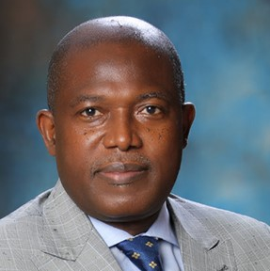
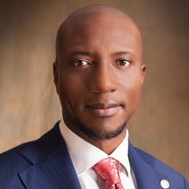
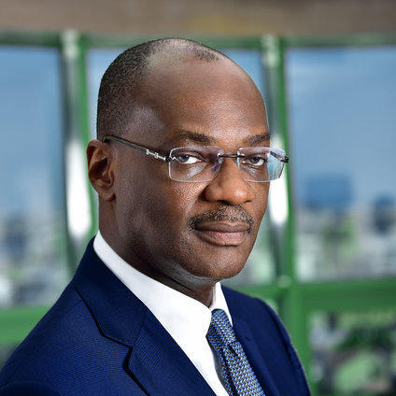
Business Opportunities in Nigeria
The GNCCT ANNUAL FORUM
Web Event - January 21st, 2021, 13.00 (GMT)
Discover the key sectors presenting opportunities of the Nigerian Market.
Explore ways to seize opportunities in these sectors through financing and government incentives.
Learn ways to work closely with GNCCT and Nigerian Institutions to successfully materialize your vision and plans.
Find out about success stories and best practices for accessing the Nigerian Market.
Mr. Abimbola Ogunbanjo
Event Moderator
Chairman Nigerian Stock Exchange
Mr. Kostas Fragogiannis
Honourable Deputy Minister Greece Ministry of Foreign Affairs
Economic Diplomacy
Otunba Niyi Adebayo
Honourable Minister Nigeria
Ministry of Industry, Trade and Investment
Mr. Michael E. Economakis
Chairman, GNCCT
Ms. Yewande Sadiku
CEO
Nigerian Investment Promotion Commission
Mr. Olukayode A. Pitan
CEO
Bank of Industry of Nigeria
Mr. Oscar N. Onyema
CEO Nigerian Stock Exchange
Mr. Harry David
Managing Partner
Leventis Group
Mr. Kunle Elebute
Senior Partner, KPMG Nigeria Chairman, KPMG Africa
Under the Auspices of:

Slide 2
Business Opportunities in Nigeria
The GNCCT ANNUAL FORUM
Event Agenda - Thursday, January 21st, 2021
13.00 GMT – 14.00 Nigeria – 15.00 Greece
Part 1
Chairman, GNCCT
Representative from the Hellenic Federation of Enterprises
Representative from the Athens Chamber of Commerce and Industry
The Honourable, Minister of Industry, Trade and Investment, Nigeria
The Honourable Deputy Minister of Foreign Affairs for Economic Diplomacy, Greece
Part 2
Mr. Abimbola Ogunbanjo, Moderator, Chairman, Nigerian Stock Exchange
Ms. Yewande Sadiku – ES/CEO, Nigerian Investment Promotion Commission
Mr. Olukayode Pitan – CEO Bank of Industry, Nigeria
Mr. Oscar N. Onyema, - CEO Nigerian Stock Exchange TBC
Mr. Harry David, Managing Partner, Leventis Group
6. Mr. Kunle Elebute, Senior Partner, KPMG Nigeria & Chairman, KPMG Africa
Part 3
Closing Remarks from Chairman or Secretary General of GNCCT
Q&A
Web Event- Thursday, January 21st, 2021
13.00 (GMT) / 14.00 (Nigeria) /15.00 (Greece)
Event participation is Free of Charge.
Please register to the event here.
or copy the below address to your web browser: http://alternativemedia.gr/gncct/
The event will start on time. Please make sure you log in to the event platform 5 minutes earlier.
For clarifications or requests, please email info@gncct.gr
Under the Auspices of:

